Slide 1
Automated Feature Extraction for High-Throughput Synchrotron Characterization
SSRL / SLAC
Alexander Ivanov, Robert Tang-Kong, Suchismita Sarker, Apurva Mehta

Slide 2
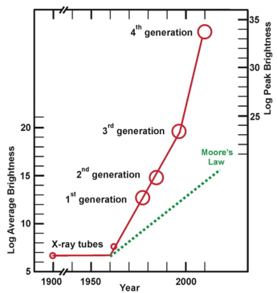
Light Sources Brighter than Ever Before
We can do more experiments, so where are the publications?
J. B. Parise and G. E. Brown, Jr. Elements, 2, 37-42 (2006)
Notes:
You all know this, preaching to the choir
Measurements vs knowledge
Rate of discovery, why?
Caveat: problems are getting more complex, need more data
End result is still lots of data that is not being analyzed
2006: 100 patterns a day
LCLS: >1E4-6 patterns per day
<number>

Slide 3
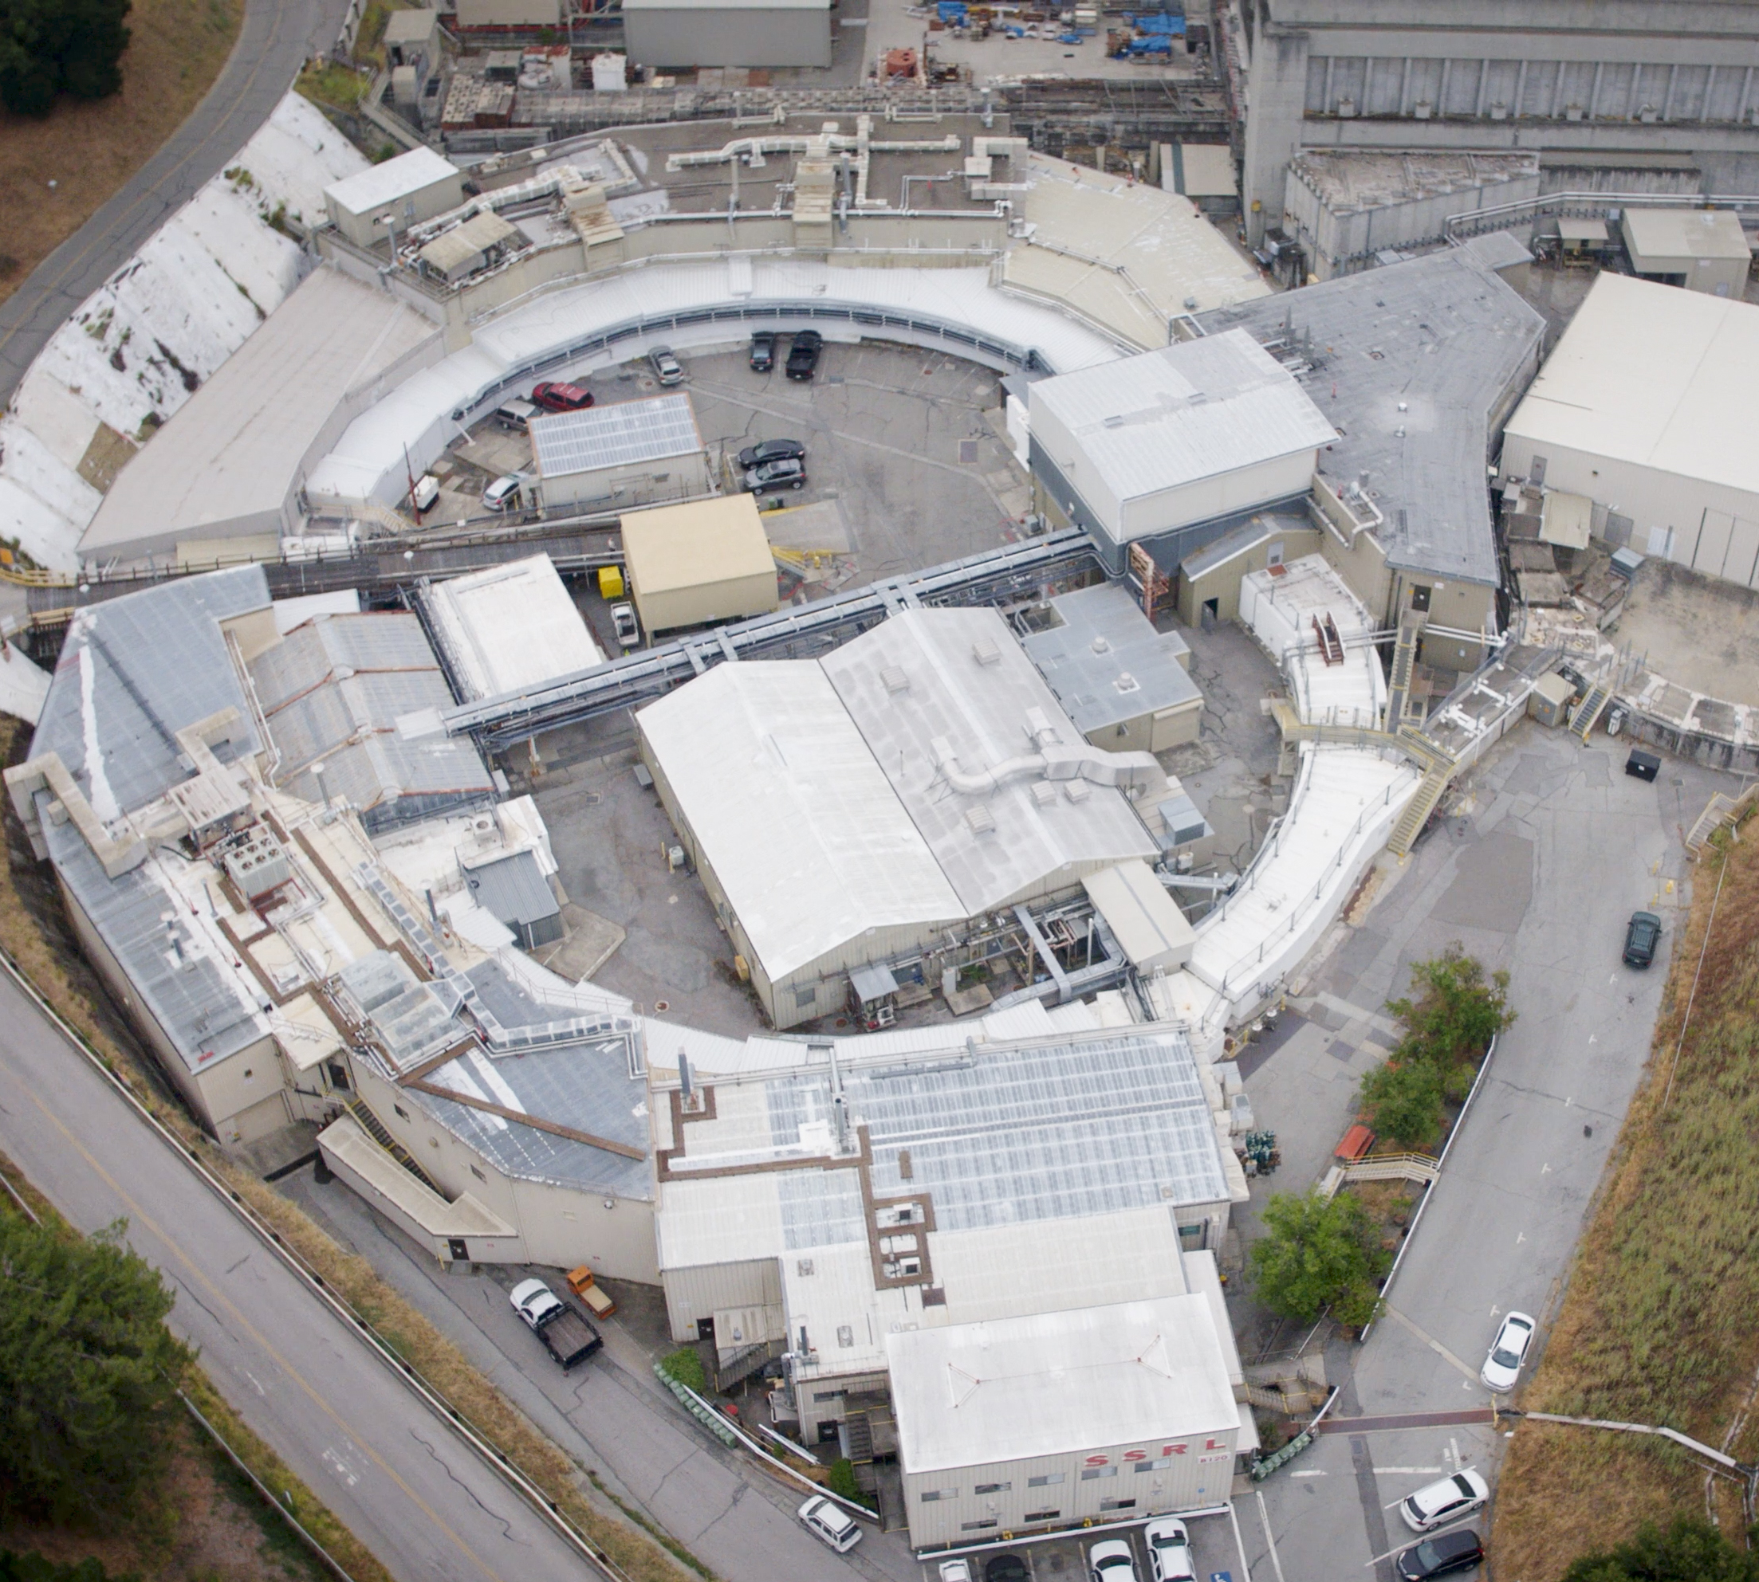
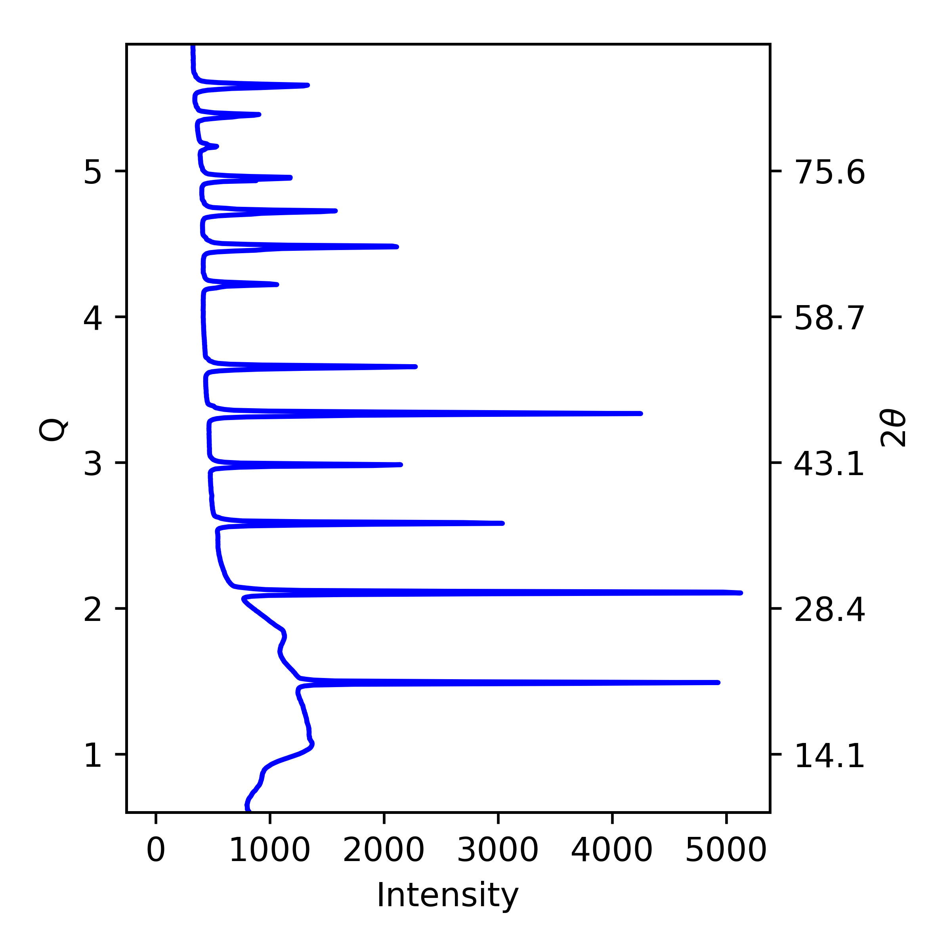
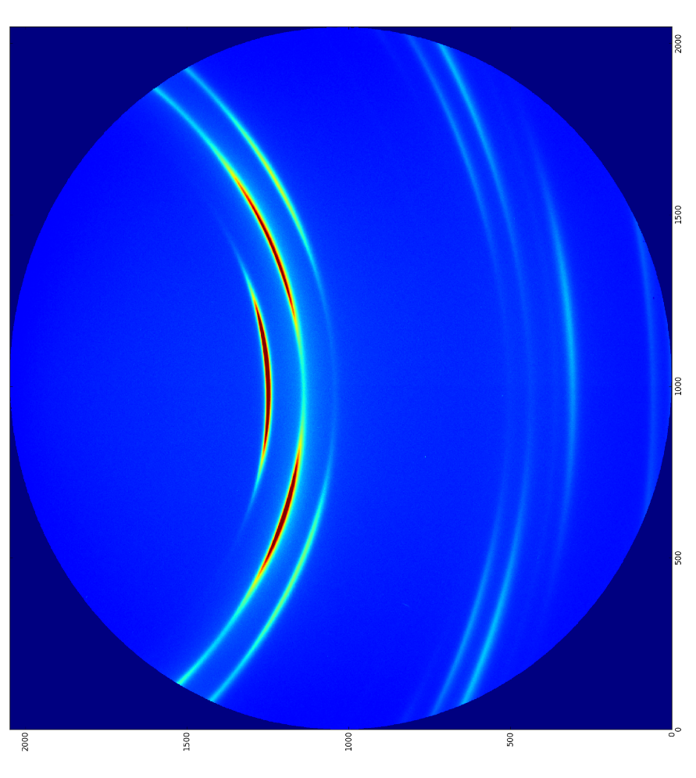
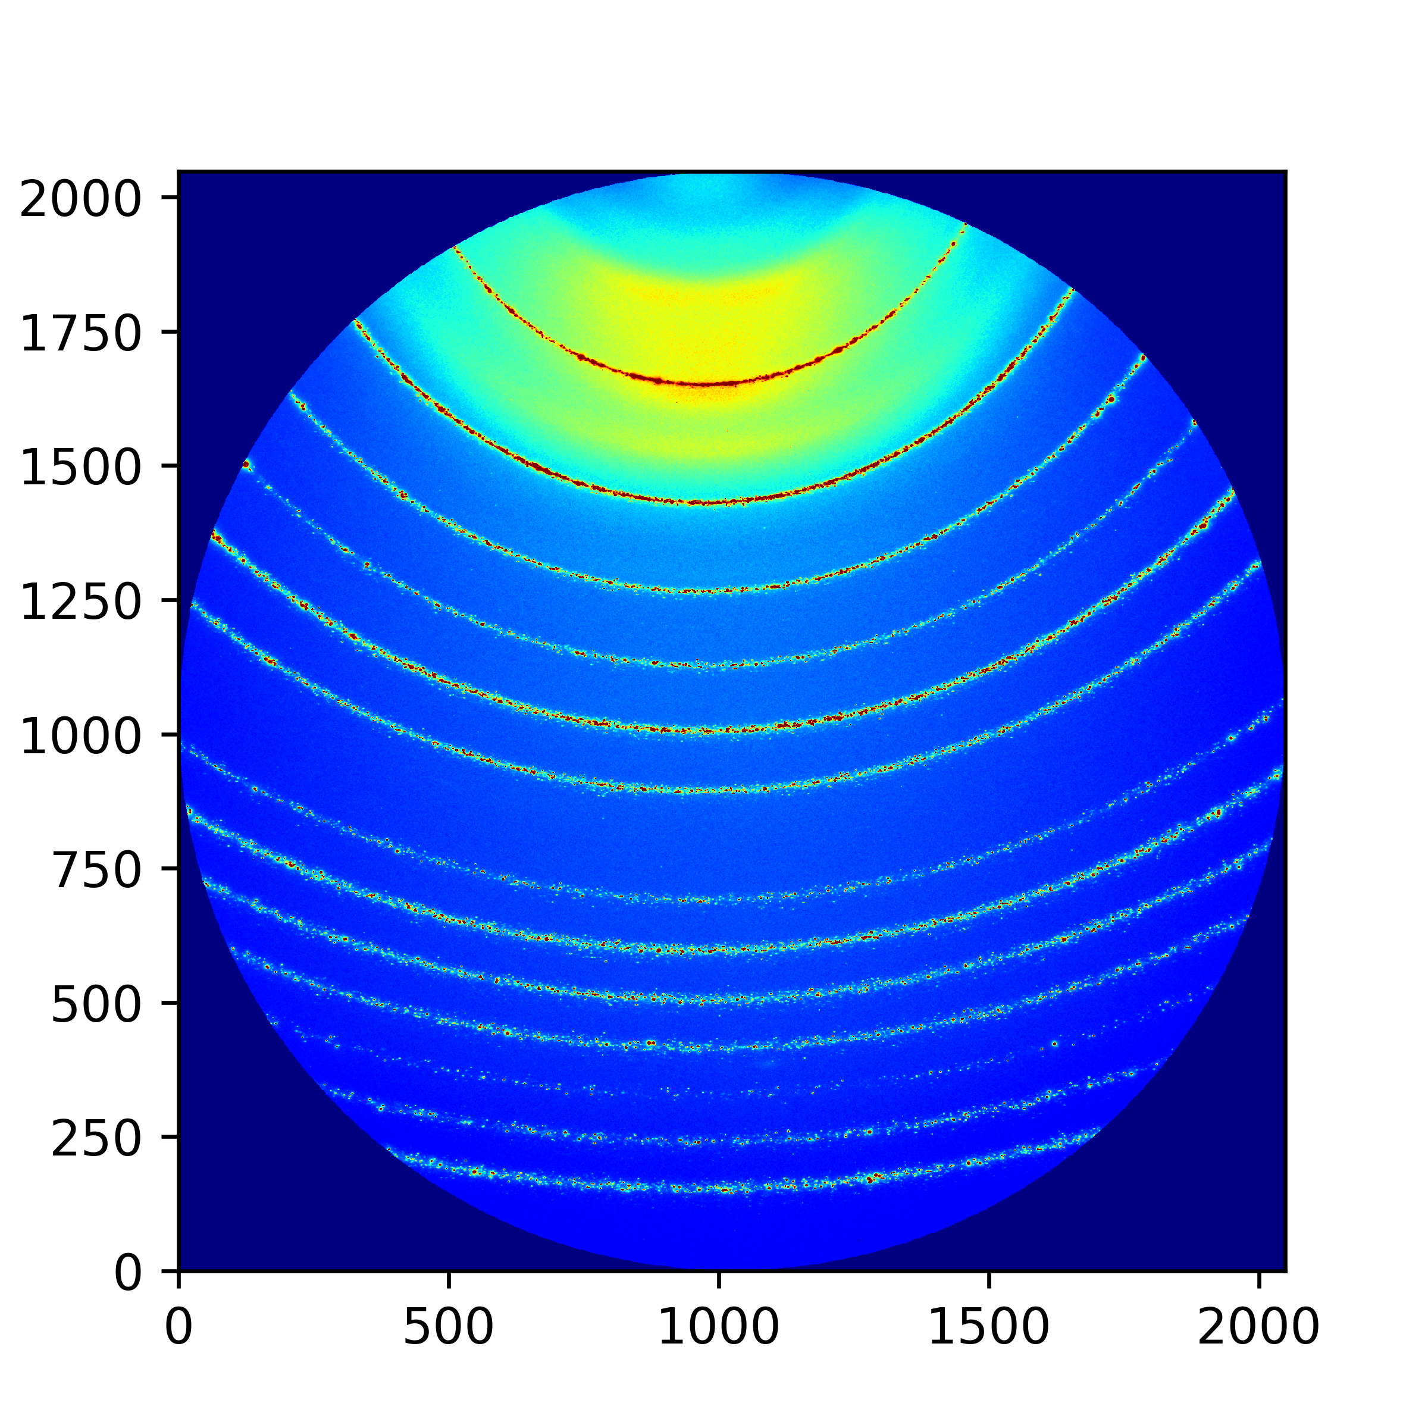
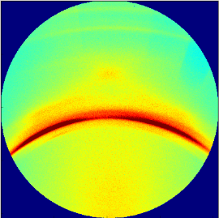
The New Bottle Neck
Measurement
Analysis
Discoveries/ Knowledge
ID | No. peaks | FWHM | Noise
… | … | … | …
1 | 2 | 0.5 | 0.07
2 | 4 | 0.3 | 0.50
… | … | … | …
<number>
Notes:
<number>

Slide 4
The New Bottle Neck
Measurement
Analysis
Discoveries/ Knowledge
ID | No. peaks | FWHM | Noise
… | … | … | …
1 | 2 | 0.5 | 0.07
2 | 4 | 0.3 | 0.50
… | … | … | …
<number>
Notes:
<number>

Slide 5
The New Bottle Neck
Measurement
Analysis
Discoveries/ Knowledge
ID | No. peaks | FWHM | Noise
… | … | … | …
1 | 2 | 0.5 | 0.07
2 | 4 | 0.3 | 0.50
… | … | … | …
<number>
Notes:
<number>

Slide 6
Feature Extraction
ID | No. peaks | FWHM | Noise
… | … | … | …
1 | 2 | 0.5 | 0.07
2 | 4 | 0.3 | 0.50
… | … | … | …
<number>
Notes:
<number>

Slide 7
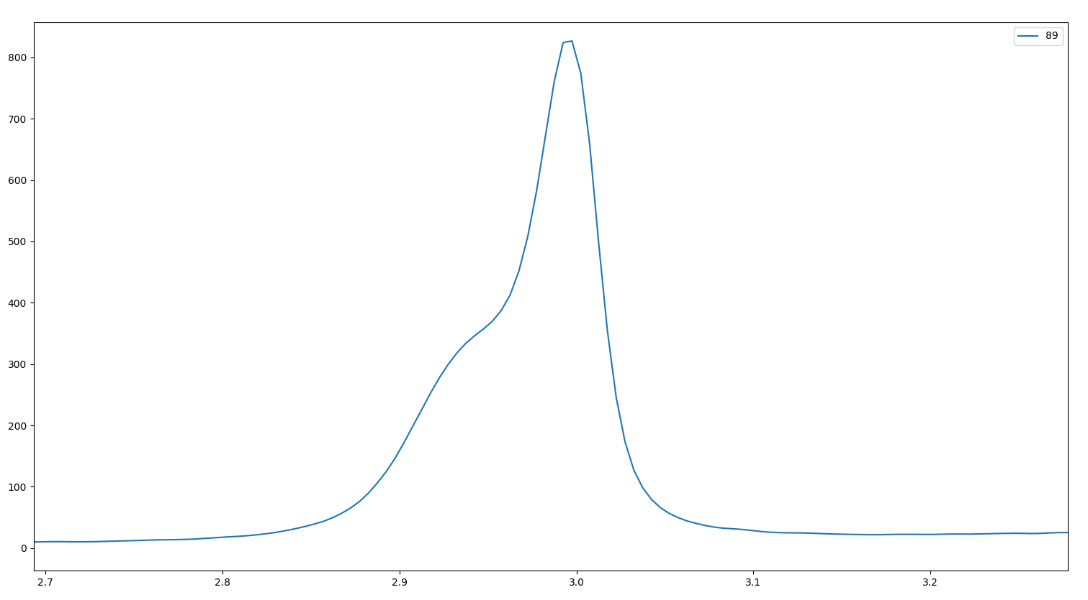
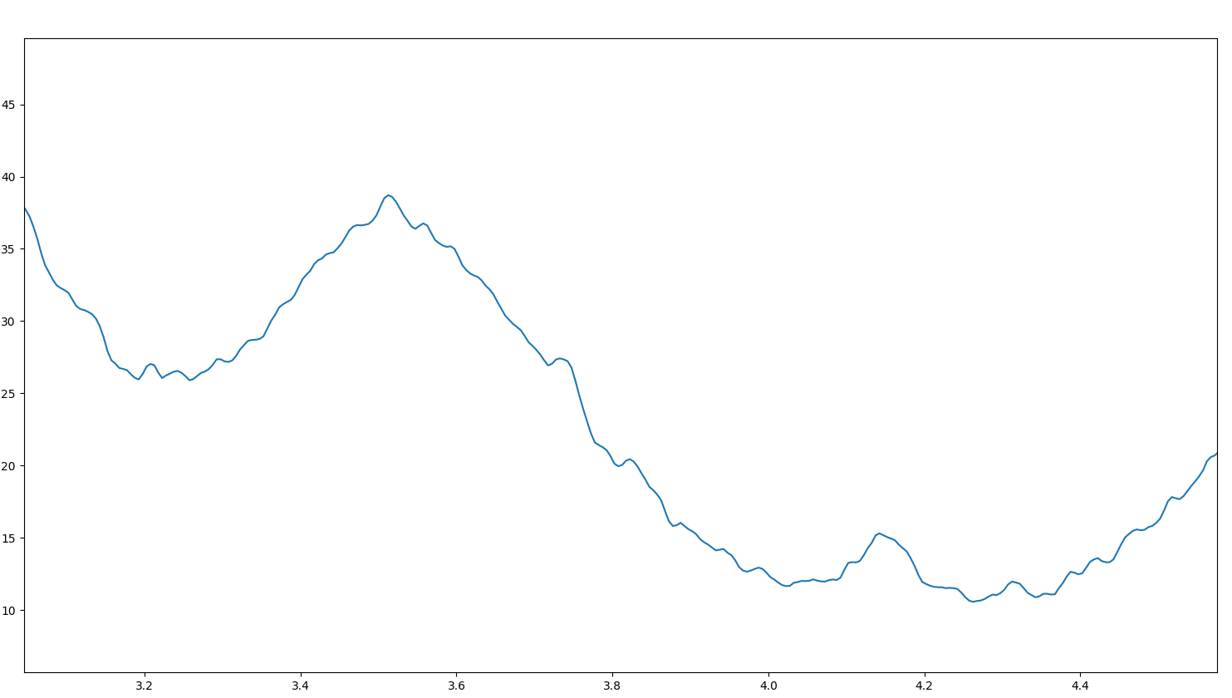
Challenges of Detecting Peaks
Overlapping Peaks
Noisy Data
<number>
Notes:
<number>

Slide 8
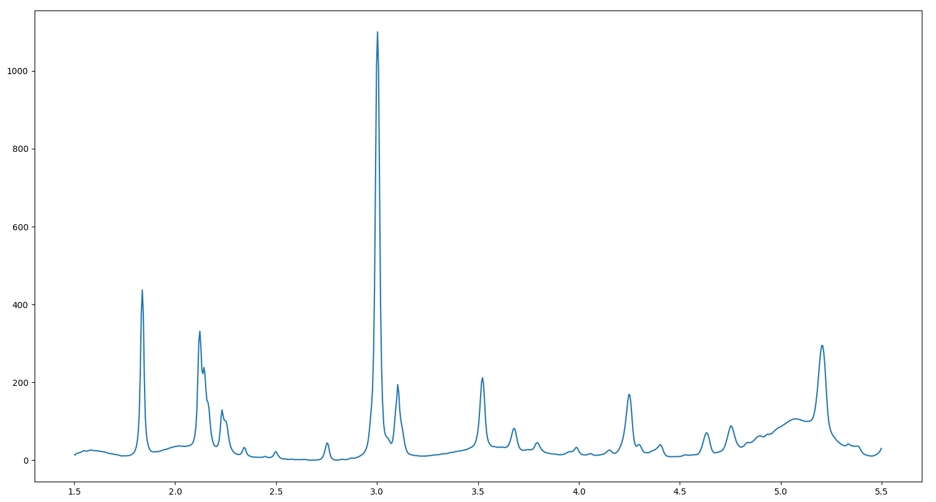
Challenges of Detecting Peaks
Curve Fitting
Number of peaks
Computationally hard
<number>
Notes:
<number>

Slide 9
Challenges of Detecting Peaks
Curve Fitting
Number of peaks
Computationally hard
<number>
Notes:
<number>

Slide 10
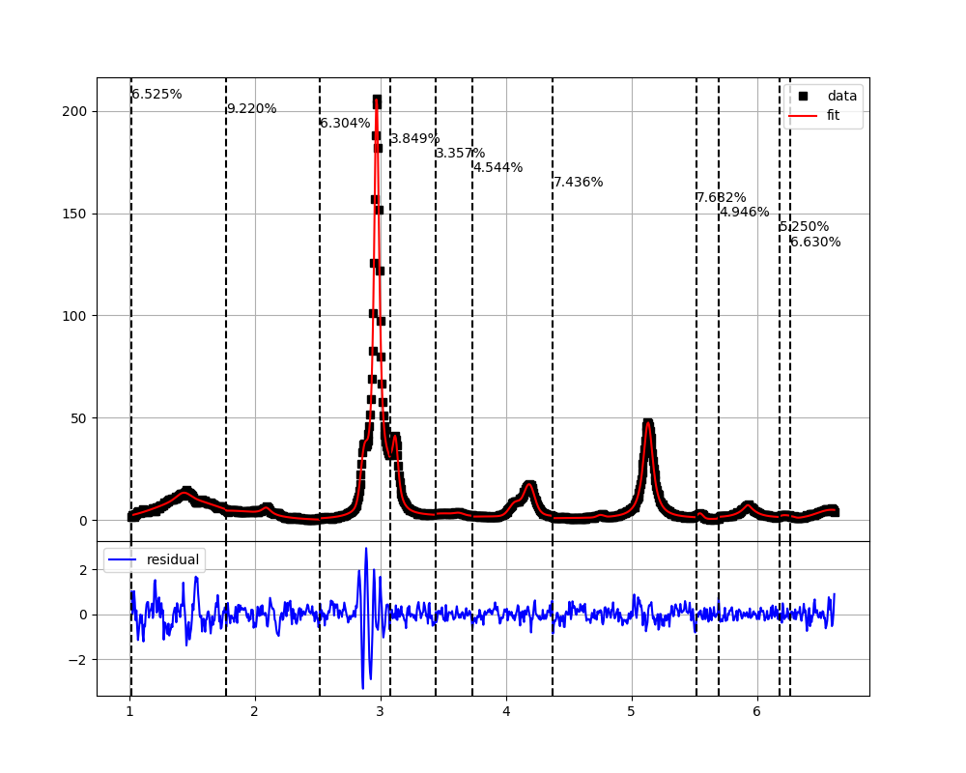
Bayesian Block Analysis
Bayesian Block Analysis for Peak Detection
Block data into statistically similar regions.
Hill climbing on blocks
Produce peak regions for peak fitting
<number>
Notes:
<number>

Slide 11
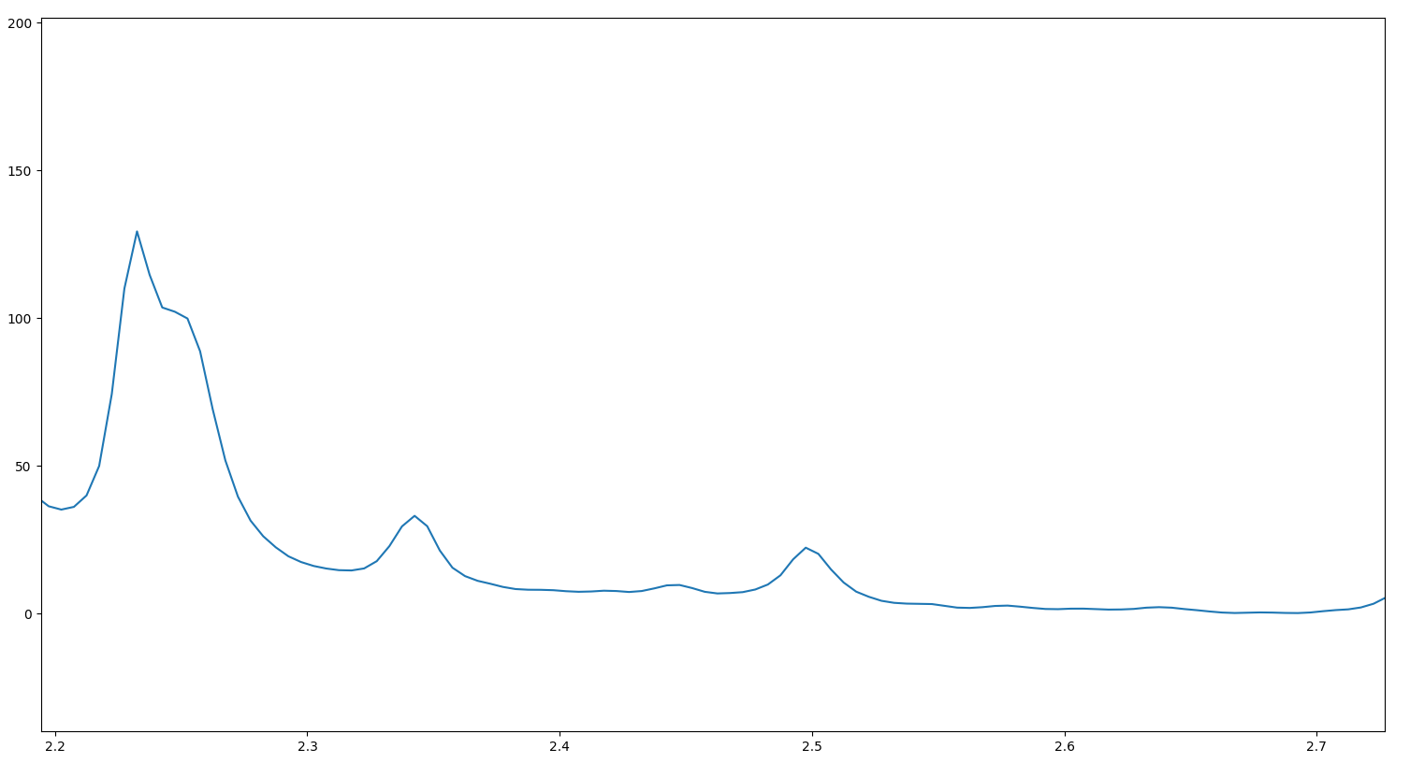
Bayesian Block Analysis
<number>
Notes:
<number>

Slide 12
Bayesian Block Analysis
<number>
Notes:
<number>

Slide 13
Bayesian Block Analysis
<number>
Notes:
<number>

Slide 14
Bayesian Block Analysis
<number>
Notes:
<number>

Slide 15
Bayesian Block Analysis
<number>
Notes:
<number>

Slide 16
Bayesian Block Analysis
1
2
3
<number>
Notes:
<number>

Slide 17
Bayesian Block Analysis
1
2
3
<number>
Notes:
<number>

Slide 18
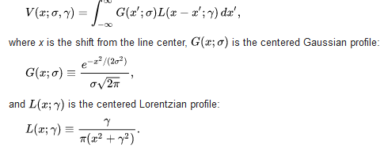
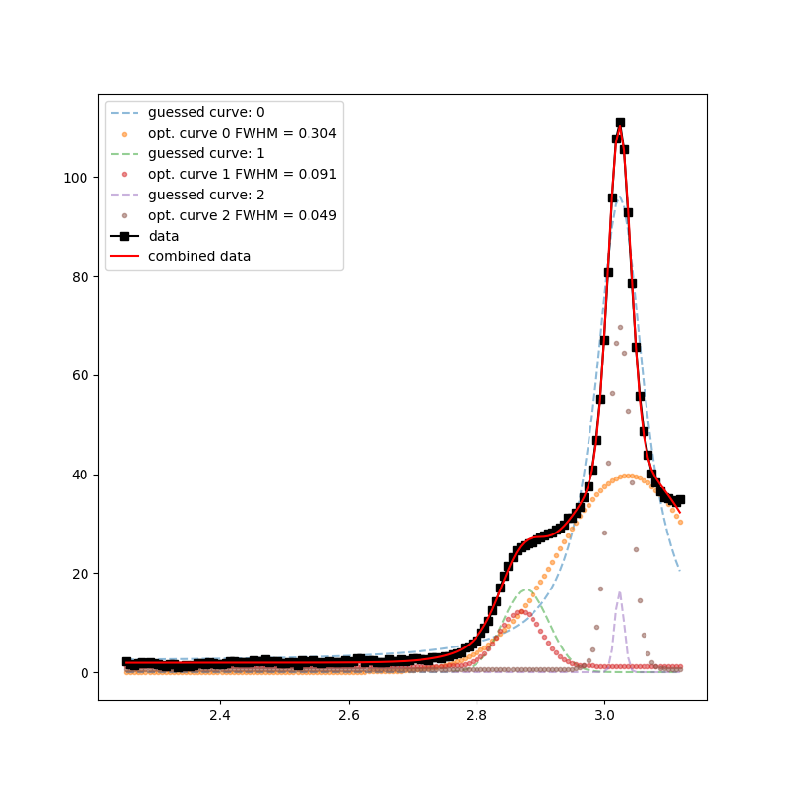
Peak Fitting
Assumptions
Voight profile
Symetric
Algorithm
Place curve at peak in data
Subtract curve to get new data
Repeat until all curves are placed
Optimize all curves together on original data

Slide 19
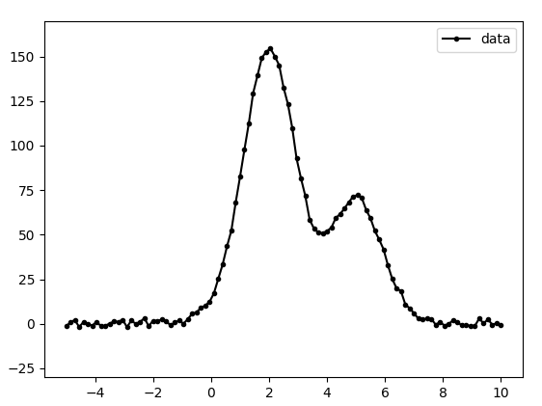
Peak Fitting
<number>
Notes:
<number>

Slide 20
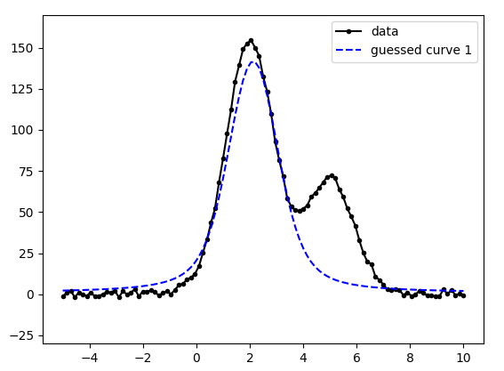
Peak Fitting
<number>
Notes:
<number>

Slide 21
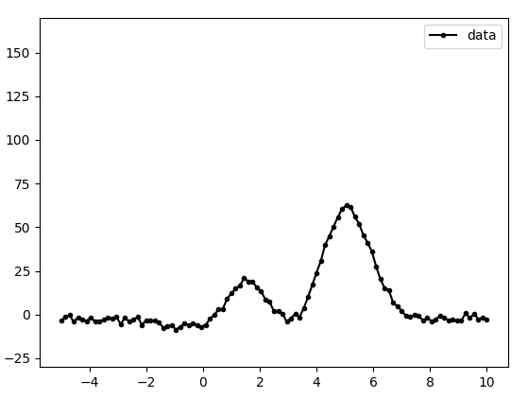
Peak Fitting
<number>
Notes:
<number>

Slide 22
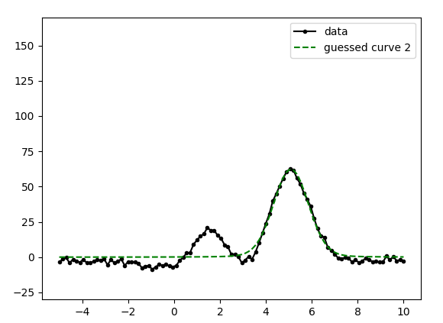
Peak Fitting
<number>
Notes:
<number>

Slide 23
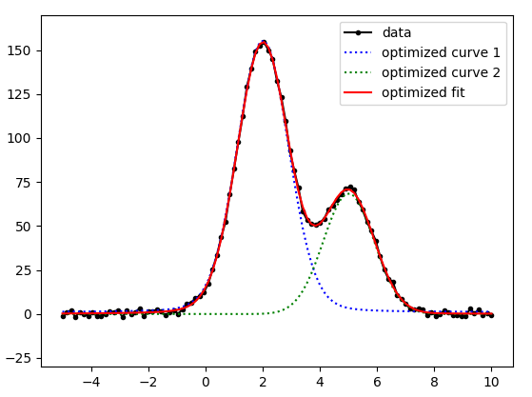
Peak Fitting
<number>
Notes:
<number>

Slide 24
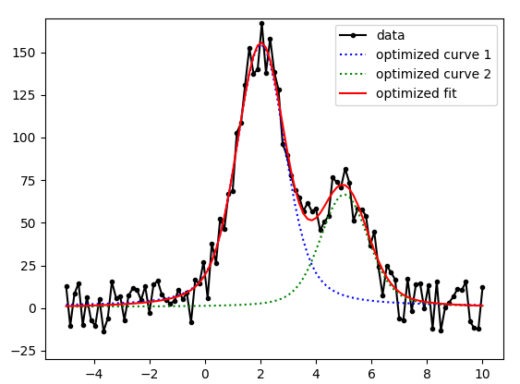
Peak Fitting
<number>
Notes:
<number>

Slide 25
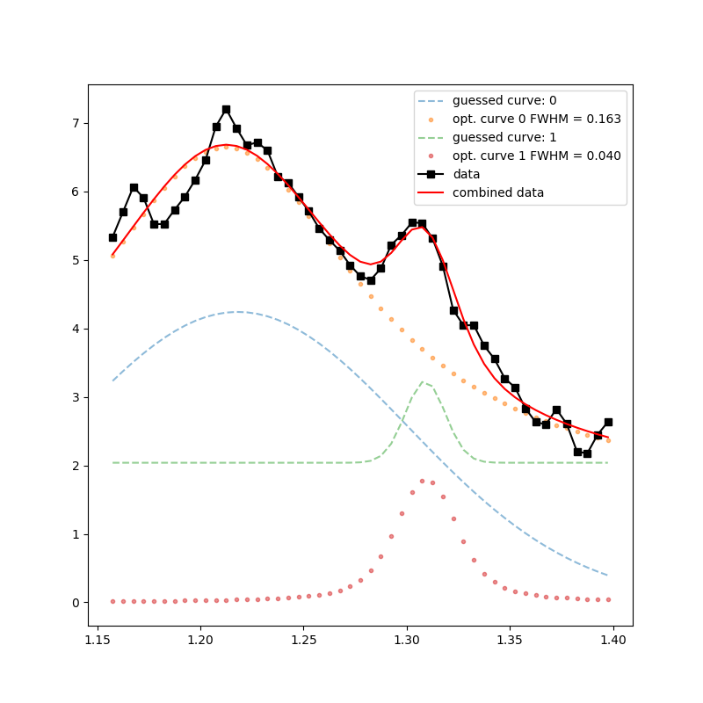
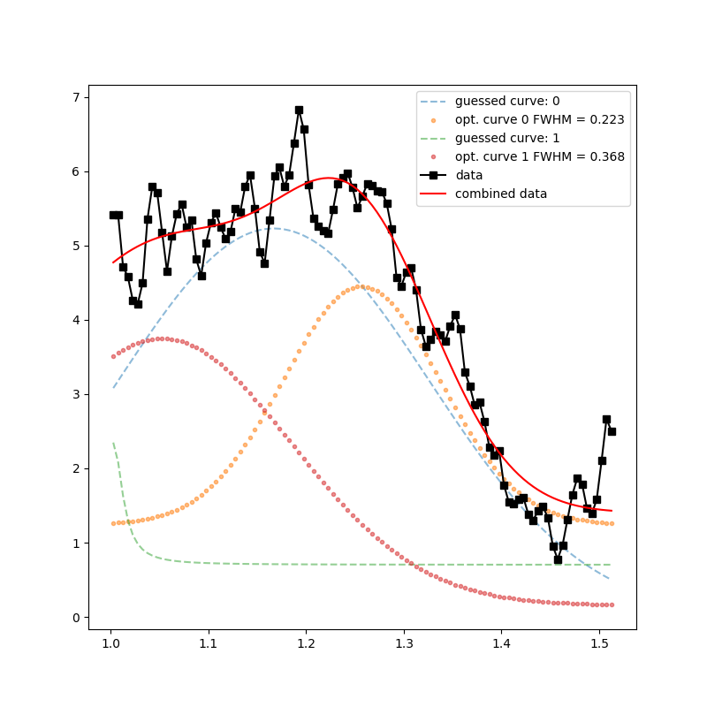
Results
<number>
Notes:
<number>

Slide 26
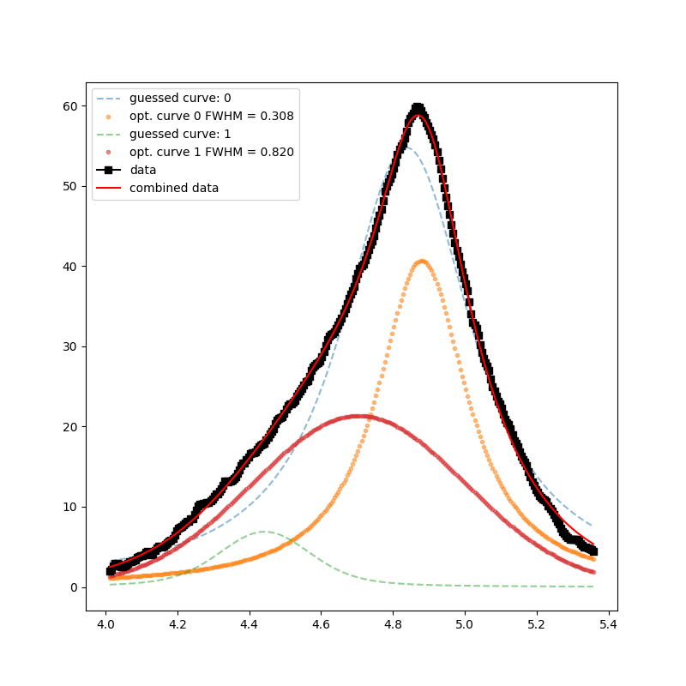
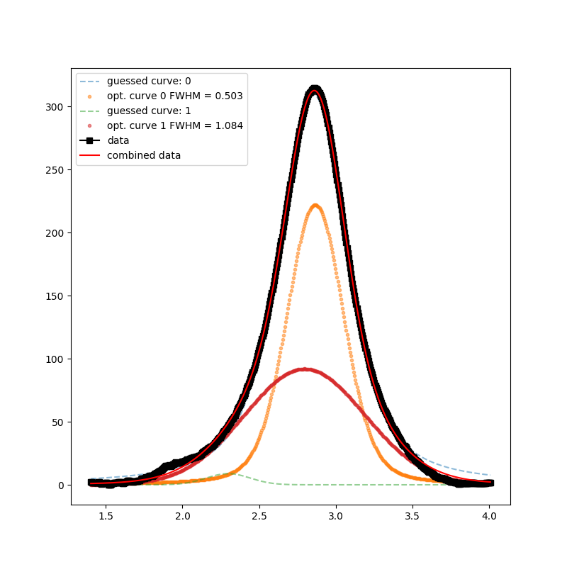
Results
<number>
Notes:
<number>

Slide 27

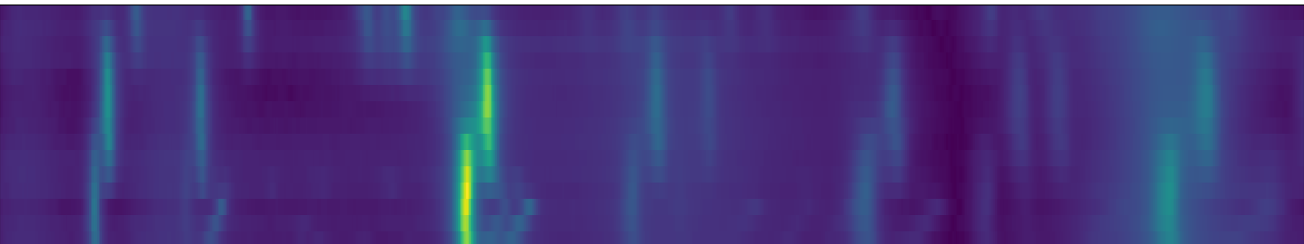
Further Directions
Improved Algorithm
Better blocking
Detecting peaks with computer vision
Higher dimensional peak fitting
<number>
Notes:
<number>

Slide 28
Further Directions
Thank DE
<number>
Notes:
<number>

Slide 29
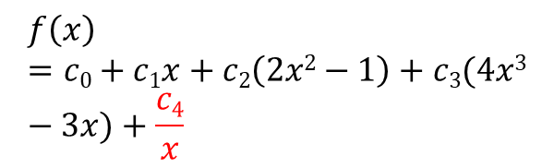
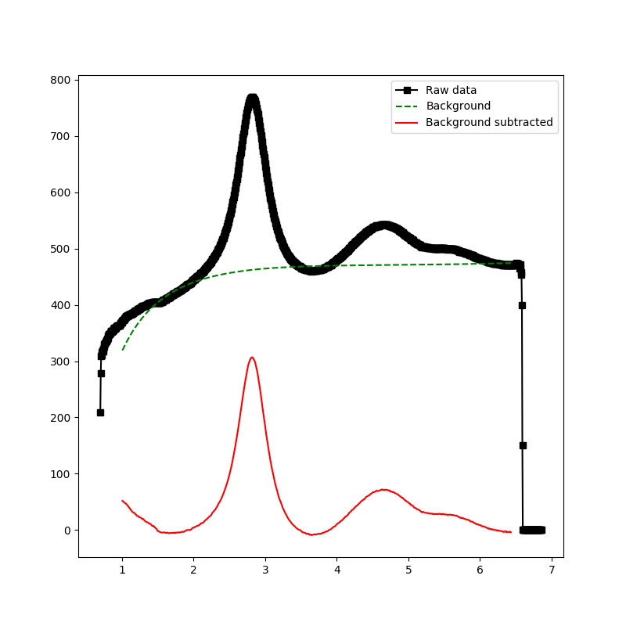
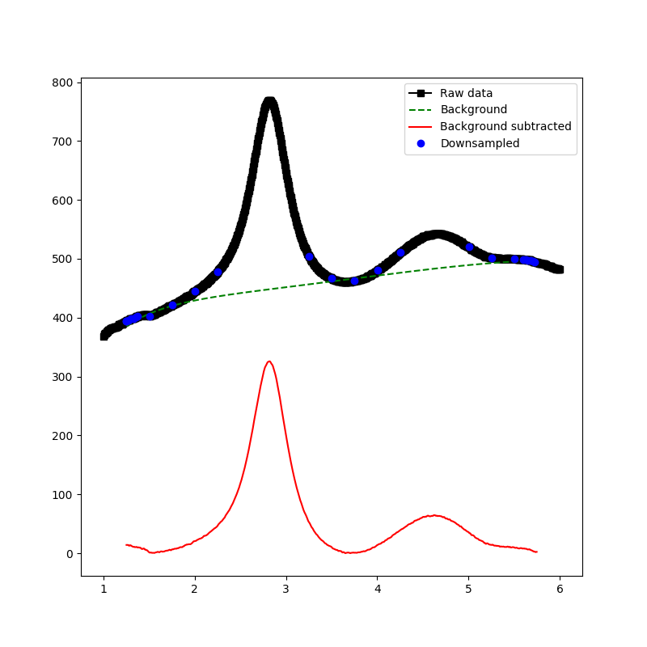
Background Subtraction
Modified Chebyshev Polynomial
Take points below median
Emphasize edge points to pin edges of function
<number>
Notes:
<number>

Slide 30
Background Subtraction
Modified Chebyshev Polynomial
Take points below median
Emphasize edge points to pin edges of function
<number>
Notes:
<number>

